Slide 1

State MEDICATION utilization
(2022)

Slide 2



Meet our team
GROUP 05-001
VIKRANT SIWACH
SUJATA BISWAS
SRIKANTH AYYALASOMAYAJULA
LinkedIn
GitHub
LinkedIn
GitHub
LinkedIn
GitHub

Slide 3

BACKGROUND MOTIVATION
The medicinal drug usage is an important aspect and component of healthcare industry for United States of America (USA).
This is also an essential area of study for healthcare policymakers and professionals. Although the use of pharmaceuticals has significantly increased in recent years due to their success in treating a variety of medical conditions along with their accessibility and affordability, misuse can result in poor health conditions, higher healthcare costs, and prolonged patient recovery.
Identifying the patterns in drug usage of different states and comparing with different timelines can support such policymakers and professionals to track commonly used drugs and their consumption patterns.
FFS (Fee-for-Service) and MCO (Managed Care Organizations) are two types of utilization of medicines

Slide 4

Problem statement
Such crucial information further support in identifying different trends of drug consumption in people with different lifestyles and backgrounds.
Furthermore, they give an insight of types of drug consumption by a specific state and their respective health department’s expenses.
Lack of reliable and regular analysis reports for various years of data on medicinal drug utilization across various US states accounts for the difference between the present situation and the future situation.
It is difficult to create strategies that can optimise the use of pharmaceuticals and enhance public health outcomes without this knowledge.

Slide 5

PROJECT PROPOSAL
AIM
METHOD
Our team will identify various trends and patterns in utilization methods by taking important factors into account to complete the project and provide accurate and meaningful visuals of the same on drug utilization of various US states.
This will lead the health department to investigate factors that affect utilization patterns and discover insights on utilization status with each year.
Furthermore, this can also support them in developing effective policies and interventions to promote their safe and effective use.
We will analyze the data using various statistical techniques and give the healthcare department images that more effectively and meaningfully illustrate things like utilization type, departmental expenses, and units given to patients.

Slide 6

ASPECTS Aimed TO HELP HEALTHCARE DEPARTMENT
IMPROVISION
IDENTIFYING PATTERNS
COST MANAGEMENT
STRATEGIZING POLICIES
Improvising healthcare policies.
Identifying patterns of medications needed for different kinds of people.
Reduce state and health department’s costs/expenses.
Strategize existing and upcoming public health policies.

Slide 7

ANALYSIS QUESTIONS
How does the FFSU type of utilization vary in 2022 from 2021 across all the resgions of USA?
How different is the trend of the MCOU type of utilization in 2022 than what it was in 2021 across the regions of USA?
How was the behavioral change of the reimbursed amount in the two years?
How much was the behavioral change of the units reimbursed in the two years?
What medications were consumed the most? How and up to what extent does their consumption change in the four main regions of USA?

Slide 8

DATASET
DESCRIPTION
Since the implementation of the Medicaid Drug Rebate Program, states have been required to provide data on the use of medications for outpatient treatments that are covered and paid for by state Medicaid agencies.
State, drug name, National Drug Code (NDC), quantity of prescriptions, and amount of reimbursement are all included in the data.
We conclude that the project we have chosen to undertake and the objective we have set for ourselves can be successfully accomplished utilising the dataset selected by us after carefully observing the dataset and researching the variables.
Our dataset contains more than 1million records out of which more than 500k entries are missing a few column values.

Slide 9

DATA DESCRIPTION
CATEGORICAL | numerical | NUMERICAL | NUMERICAL
utilization_type | ndc | quarter | medicaid_amount_reimbursed
state | labeler_code | units_reimbursed | non_medicaid_amount_reimbursed
suppression_used | product_code | number_of_prescriptions | year
product_name | package_size | total_amount_reimbursed

Slide 10

DATA DICTIONARY
utilization_type: type of utilization- FFSU or MCOU
state: name of different states of USA
ndc: National Drug Code
labeler_code: code assigned to drugs by FDA
product_code: code assigned to drugs by the manufacturer
package_size: size of packaging of prescribed drug
suppression_used: were immunosuppressant used on patients with their prescription.
product_name: name of the drug
units_reimbursed: the units reimbursed by third parties to the company or patient
number_of_prescriptions: the prescriptions provided to the patients
total_amount_reimbursed: total amount reimbursed by third parties to the company or patient
medicaid_amount_reimbursed: reimbursement provided by state for medicinal-related assistance
non_medicaid_amount_reimbursed: reimbursement provided by state for other health-related assistance

Slide 11

Finding the dataset from a reliable source.
Checking for the availability of the file before downloading.
Identifying the various variables and medications.
Storing the dataset on Google Drive to further start working on Google Colaboratory.
Handling failures and errors (in case any).
EXPLORATORY DATA ANALYSIS

Slide 12

DATA CLEANING & TRANSFORMATION
Merging state medication utilization of 2021 & state medication utilization of 2022
Checking for missing values and removing them.
Dealing with inconsistencies in the dataset.
Segregating the various US states into US main regions for visualization.

Slide 13

DATA ANALYSIS

Slide 14
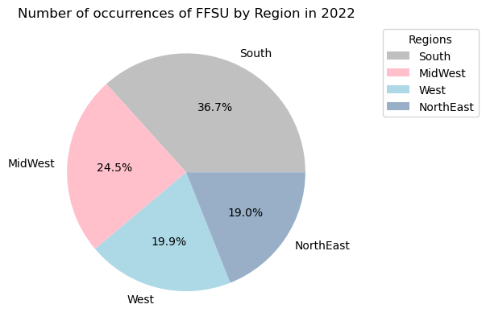
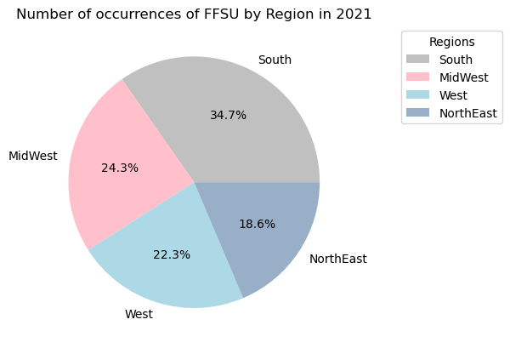
Variation in FFSU Type of Utilization in 2021 & 2022

Slide 15
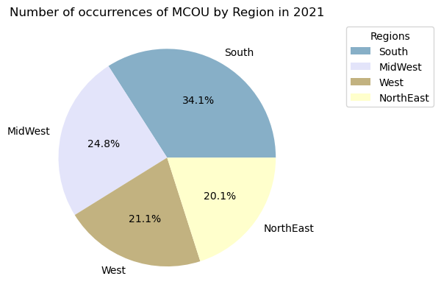
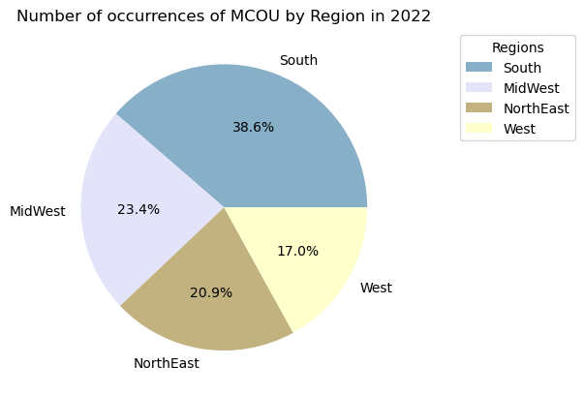
Variation in MCOU Type of Utilization in 2021 & 2022

Slide 16
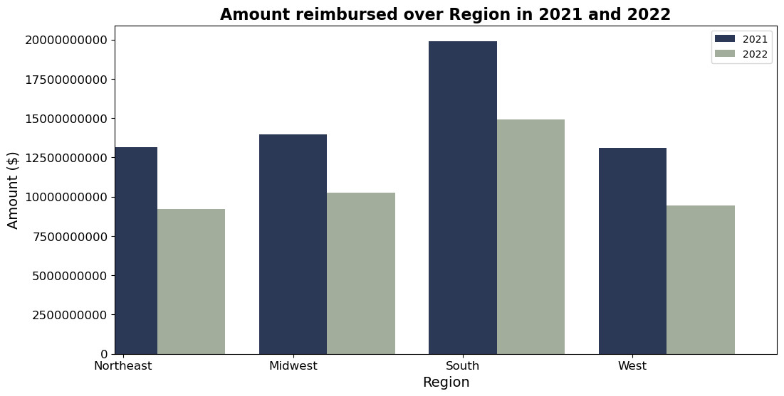

Slide 17
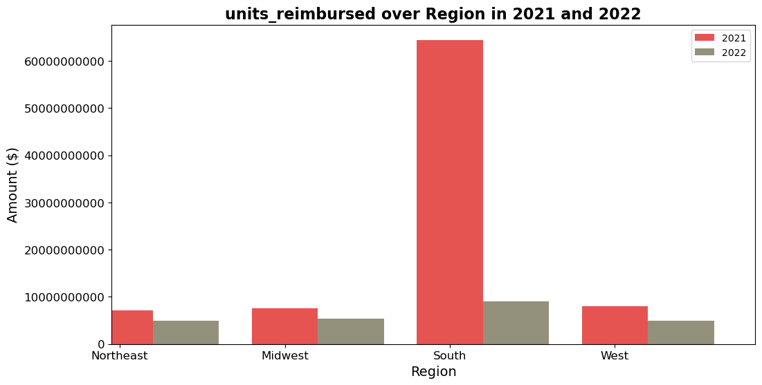

Slide 18
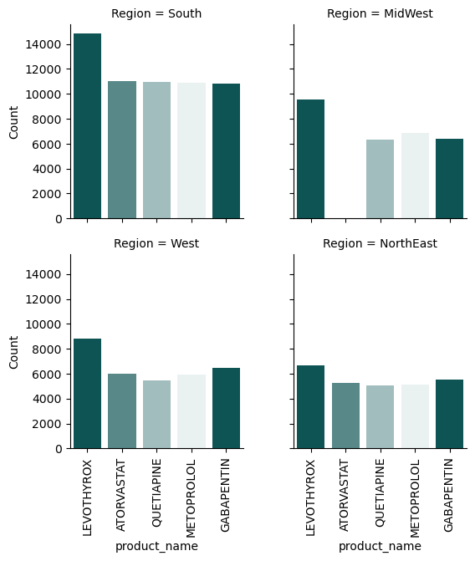
MOST CONSUMED MEDICATIONS

Slide 19

CONCLUSIONS
The Southern region utilizes the most medications in the FFSU type in both 2021 and 2022.
The Northeast has the least MCOU type of utilization in the year 2021 while in 2022 West has the least utilization.
Utmost amount was reimbursed in the Southern region in 2021 while it was approximately the same for the other e regions while in 2022 the reimbursement amount differed more than the previous year.
The most units of medications reimbursed in the two years was in the Southern region.
The highest consumed medication is ‘Levothyroxine’ used to treat an underactive thyroid gland (hypothyroidism).
‘The use of Atorvastatin’; medication in the treatment of Cholesterol, is almost negligible in the Midwest.

Slide 20

Because the Southern region has the most utilization of medications, it is advisable for the Healthcare Sector & professionals to enhance and customize(if possible) policies so as to benefit them.
The amount reimbursed being the highest in the South justifies the maximum units reimbursed in the same region. But the ration of the amount and the units reimbursed for the other regions differ abnormally.
Healthcare Department could look into this and regulate better reimbursement of medications from the other regions so as to evaluate it with the amount reimbursed.
From analysis, it is evident that a huge part of the crowd in USA is dealing with the problem of Thyroid. To overcome this issue, Healthcare Department can evaluate on how to improve the health of it’s population by cutting down the costs of thyroid associated medications or including them in future healthcare plans & policies.
RECOMMENDATIONS

Slide 21

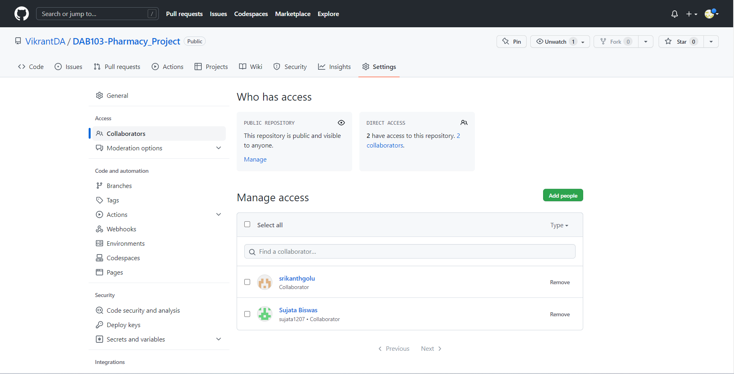
GitHub REPOSITORY https://github.com/VikrantDA/DAB103-Pharmacy_Project
Which state has the highest consumption of drugs, and which has the lowest?
Which quarter has the highest utilization compared between the two years?
How FFS type of utilization is distributed over the different states in 2013 and 2014?
How much units of drugs were reimbursed in each state?
How was the behavior of the suppression drugs across the four quarters in the two years?
What was the total Medicaid amount reimbursed by the health department in each state?
How MCO type of utilization is distributed over the different states in 2013 and 2014?

Slide 22

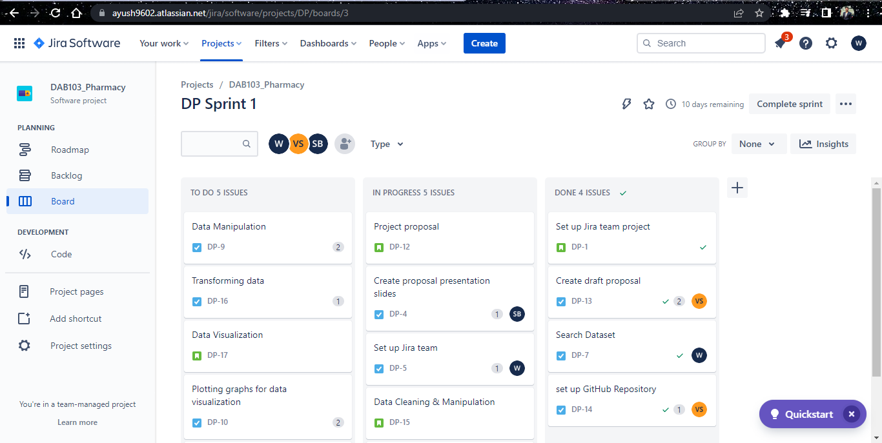
JIRA REPOSITORY
Sep
oct
nov
dec
jan
Synergize scalable
e-commerce
Disseminate standardized
metrics
Coordinate
e-business applications
Foster holistically superior methodologies
Deploy strategic networks with compelling
e-business needs

Slide 23
REFERENCES
Centers for Medicare & Medicaid Services , June 11, 2015 | State Drug Utilization 2013
data.gov/dataset
Centers for Medicare & Medicaid Services , June 11, 2015 | State Drug Utilization 2013
data.gov/dataset
Dataset source
Background motivation
Centers for Medicare & Medicaid Services , February 14, 2018 | State Drug Utilization FAQs
medicaid.gov
DATA DESCRIPTION
& DICTIONARY
U.S. Department of Health & Human Services , April 28, 2021 | What’s the difference between Medicare and Medicaid?
medicaid
OTHERS
Centers for Medicare & Medicaid Services , November 15, 2022 | Comparing Reimbursement Rates:
cms.gov

Slide 24


Thank you

